Slide 1


Department of CSE
MATHEMATICAL OPTIMIZATION
24MT2012
Topic:
LP: Simplex method
CO1; Session -

Slide 2



AIM OF THE SESSION
To familiarize students with the method of solving linear programming problems using Simplex method.
INSTRUCTIONAL OBJECTIVES
This Session is designed to:
Introduce the Standard form of LP for simplex method.
Introduce the concept of Slack variables, Tableau, Pivot element.
Teach creation of new Tableau to maximize the objective function.
Check whether optimal solution is achieved.
LEARNING OUTCOMES
At the end of this session, the students should be able to:
Formulate a linear programming problem in a standard format.
Compute the optimal value of the objective function and decision variables using Simplex method.

Slide 3
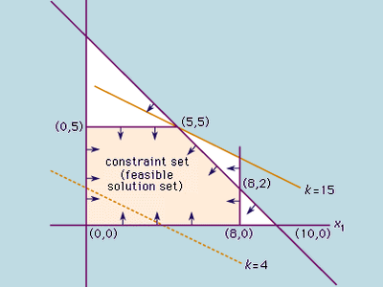
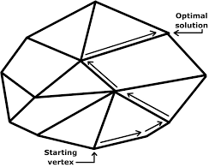
Introduction to Simplex Method
A linear program (LP) is a method of achieving the best outcome given the task of either maximizing or minimizing a linear objective function, subject to linear constraints.
Source: Encyclopedia Britanica
The simplex method uses an approach that is very efficient. It begins with a corner point of the feasibility region where all the main variables are zero. Then systematically moves from corner point to corner point, while improving the value of the objective function at each stage. The process continues until the optimal solution is found.
Source: UC Davis Mathematics
Notes:
3

Slide 4
Introduction to Simplex Method
The Simplex method is an approach to solving linear programming problems by hand using slack variables, tableau, and pivot element as a means of finding the optimal solution of an optimization problem.
Solving a LP problem using simplex method involves the following steps:
  Format the problem in Standard Form
  Convert inequality constraints to equations using slack variables
  Set up the initial simplex tableau using the objective function and the slack equations
  Check for optimality. If optimality is reached, go to step 8.
  Identify the pivot element
  Create a revised/new tableau through pivoting operations.
  Check for optimality. If optimality is NOT reached, go to step 5
  Determine the optimal value of the objective function and the decision variables.
Notes:
4

Slide 5
Problem solving using Simplex method
Identify and set up a linear program in standard minimization form
Formulate a dual problem in standard maximization form
Use the simplex method to solve the dual maximization problem
Identify the optimal solution to the original minimization problem from the optimal simplex tableau.
The procedure to solve these problems was developed by Dr. John Von Neuman. It involves solving an associated problem called the dual problem. To every minimization problem there corresponds a dual problem. The solution of the dual problem is used to find the solution of the original problem. The dual problem is a maximization problem, which we learned to solve in the last section. We first solve the dual problem by the simplex method.
First learn to convert a minimization problem into its corresponding maximization problem called its dual.
Notes:
5

Slide 6
Introducing Artificial Variable
Set up the problem.
Write a matrix whose rows represent each constraint with the objective function as its bottom row.
Write the transpose of this matrix by interchanging the rows and columns.
Now write the dual problem associated with the transpose.
Solve the dual problem by the simplex
The optimal solution is found in the bottom row of the final matrix in the columns corresponding to the slack variables, and the minimum value of the objective function is the same as the maximum value of the dual.
Notes:
6

Slide 7
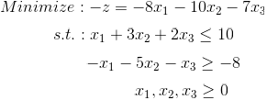


Step 1: Standard Form
Standard form has three requirements:
  must be a maximization problem
  all linear constraints must be in a <= inequality
  all variables are non-negative
The given problem is to minimize –Z. To satisfy requirement 1, let us transform the minimization problem into a maximization problem, by multiplying both the left and the right sides of the objective function by –1.
Similarly, let us transform the >= constraint to <= constraint by multiplying both sides of the constraint by –1.
Notes:
7

Slide 8

Step 2: Slack variables
Convert the <= inequalities into equations
by adding one slack variable for each inequality.
Slack variables are needed in the constraints to transform them into solvable equalities with one definite answer.
The variable s₁ represents the amount (slack) by which
x₁ + 3x₂ + 2x₃ falls short of 10.
Similarly, s₂ represents the amount (slack) by which
x₁ + 5x₂ + x₃ falls short of 8.
Notes:
8

Slide 9

Step 3: Set up the initial Tableau: preparation
A Simplex tableau is used
  to perform row operations on the LP model, and
  to check a solution for optimality.
The current LP model is shown on the right.
The tableau will be created from the coefficients of the 3 equations, (re-)written as shown on the right.
The first equation corresponds to the objective function.
The latter 2 equations correspond to the 2 constraints.
8x₁ +10x₂ +7x₃ +0s₁ +0s₂ = z
1x₁ +3x₂ +2x₃ +1s₁ +0s₂ = 10
1x₁ +5x₂ +1x₃ +0s₁ +1s₂ = 8
Notes:
9

Slide 10
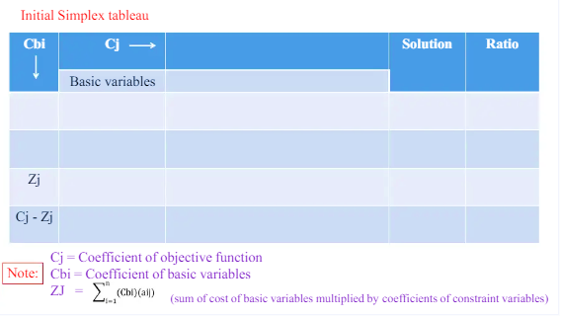

Slide 11
Step 3: Set up the initial Tableau: C_{j}s
8x₁ +10x₂ +7x₃ +0s₁ +0s₂ = z
1x₁ +3x₂ +2x₃ +1s₁ +0s₂ = 10
1x₁ +5x₂ +1x₃ +0s₁ +1s₂ = 8
In the tableau below,
the 2nd row of the tableau lists all the variables.
The top row lists the coefficients of these variables in the objective function:
    C_{j}: coefficient in the jth column
The last two rows list the coefficients in the two linear constraints.
The last column contains the numbers on the RHS of the equations.
C_{j} -> | 8 | 10 | 7 | 0 | 0
 | x1 | x2 | x3 | s1 | s2 | b
 | 1 | 3 | 2 | 1 | 0 | 10
 | 1 | 5 | 1 | 0 | 1 | 8
Tableau
Notes:
11

Slide 12
Step 3: Set up the initial Tableau: basic variables
 | C_{j} -> | 8 | 10 | 7 | 0 | 0
C_{Bi} | Basic variables | x1 | x2 | x3 | s1 | s2 | b
0 | s1 | 1 | 3 | 2 | 1 | 0 | 10
0 | s2 | 1 | 5 | 1 | 0 | 1 | 8
basic variables:
A variable is called a basic variable if it's column (in the tableau above) contains 1 in a row and zeros in all other rows.
Here, the s1 column contains 1 in the 1st row (below the horizontal line) and zeros in all other rows. So, s1 is a basic variable in the 1st row.
Similarly, s2 is a basic variable in the 2nd row.
In the objective function ( z = 8x1 + 10x2 +7x3 +0s1 +0s2 ), the coefficients of the basic variables (s1 and s2) are zero. These (C_{Bi}) are written in the left most column above.
Notes:
12

Slide 13
Step 3: Set up the initial Tableau: z_{j}s
 | C_{j} -> | 8 | 10 | 7 | 0 | 0
C_{Bi} | Basic variables | x1 | x2 | x3 | s1 | s2 | b
0 | s1 | 1 | 3 | 2 | 1 | 0 | 10
0 | s2 | 1 | 5 | 1 | 0 | 1 | 8
 | z_{j} | 0 | 0 | 0 | 0 | 0 | 0
 | _{Cj - zj} | 8 | 10 | 7 | 0 | 0
z_{j}s: z_{j} = Σ_{i} C_{Bi} a_{ij}
1st column: z1 = 0 x1 + 0x1 = 0
Similarly, z_{i} (I=1 to 6) is zero in all 6 columns. Write these zi values in a row below.
Now, in each of the 6 columns, compute C_{j} – z_{j} and write them in the last row.
Notes:
13

Slide 14
Step 4: Check for optimality
 | C_{j} -> | 8 | 10 | 7 | 0 | 0
C_{Bi} | Basic variables | x1 | x2 | x3 | s1 | s2 | b
0 | s1 | 1 | 3 | 2 | 1 | 0 | 10
0 | s2 | 1 | 5 | 1 | 0 | 1 | 8
 | z_{j} | 0 | 0 | 0 | 0 | 0 | 0
 | _{Cj - zj} | 8 | 10 | 7 | 0 | 0
A solution is optimum (maximum) if all ( Cj – zj ) values in the last row of the tableau are <= zero.
In the above tableau, there are 3 positive values of ( Cj – zj ). So, this solution is NOT optimal.
So, we will go to step 5.
Notes:
14

Slide 15
Step 5: Identify pivot row/column and pivot element
 | C_{j} -> | 8 | 10 | 7 | 0 | 0
C_{Bi} | Basic variables | x1 | x2 | x3 | s1 | s2 | b | ratio
0 | s1 | 1 | 3 | 2 | 1 | 0 | 10 | 10/3
0 | s2 | 1 | 5 | 1 | 0 | 1 | 8 | 8/5
 | z_{j} | 0 | 0 | 0 | 0 | 0 | 0
 | _{Cj - Zj} | 8 | 10 | 7 | 0 | 0
Pivot column: In the Cj – zj row, there are 3 positive values: 8, 10 and 7. Pick the largest value. In our case, it is 10. The column containing this number is called the pivot column. In our case, it is the x2 column (outlined in yellow color).
Pivot row: In each of the linear constraint row, compute the ratio of b to the value in the pivot column of that row. For example, b in the first row is 10 and the value in the pivot (x2) column in that row is 3. So, the ratio for the 1st row is 10/3. The ratio for the 2n row is 8/5. The row containing the smallest ratio is called the pivot row. In our case, 2nd row (green) is the pivot row.
Notes:
15

Slide 16
Step 5: Identify pivot row/column and pivot element
 | C_{j} -> | 8 | 10 | 7 | 0 | 0
C_{Bi} | Basic variables | x1 | x2 | x3 | s1 | s2 | b | ratio
0 | s1 | 1 | 3 | 2 | 1 | 0 | 10 | 10/3=3.33
0 | s2 | 1 | 5 | 1 | 0 | 1 | 8 | 8/5=1.6
 | z_{j} | 0 | 0 | 0 | 0 | 0 | 0
 | _{Cj - zj} | 8 | 10 | 7 | 0 | 0
Pivot element: The value present in the pivot column (x2 column) and in the pivot row (2nd row) is called pivot element. In our case, the value is 5.
The basic variable in the pivot row is called the leaving variable. So, s2 is the leaving variable.
The variable in the pivot column is called the entering variable. So, x2 is the entering variable.
In the next step (of revision of the tableau), the entering variable (x2) will become the basic variable, replacing the leaving variable (s2).
Notes:
16

Slide 17
Step 6: Create a New Tableau via Pivoting
Pivoting is a process (involving row operations) of
  obtaining a 1 in the location of the pivot element, and
  making all other entries zeros in that (pivot) column.
 | C_{j} -> | 8 | 10 | 7 | 0 | 0
C_{Bi} | Basic variables | x1 | x2 | x3 | s1 | s2 | b | ratio
0 | s1 | 1 | 3 | 2 | 1 | 0 | 10
10 | x2 | 1/5 | 1 | 1/5 | 0 | 1/5 | 8/5
 | z_{j}
 | _{Cj - zj}
Old tableau with revised pivot row
a) Obtain a 1 in the location of the pivot element:
The value of the pivot element was 5 in the old tableau. Divide every element of the pivot row (row 2 in our case) by the value of the pivot element, i.e., 5, to obtain a revised pivot row (shown in red colour). Now, the revised pivot has value 1 in the pivot column (x2 column).
Notes:
17

Slide 18
 | C_{j} -> | 8 | 10 | 7 | 0 | 0
C_{Bi} | Basic variables | x1 | x2 | x3 | s1 | s2 | b | ratio
0 | s1 | 1 | 3 | 2 | 1 | 0 | 10
10 | x2 | 1/5 | 1 | 1/5 | 0 | 1/5 | 8/5
 | z_{j}
 | _{Cj - zj}
Old tableau with revised pivot row
b) Via row operations, make all entries zero in the (pivot) column of all remaining (non-pivot) rows.
Let n denote the value in the pivot column of a row. The new row is obtained by the following rule:
Value in the new row = value in the old row – n * value in the pivot row
In the next slide, the steps of revising the 1st row is illustrated.
Notes:
18

Slide 19
 | C_{j} -> | 8 | 10 | 7 | 0 | 0
C_{Bi} | Basic variables | x1 | x2 | x3 | s1 | s2 | b | ratio
0 | s1 | 1 | 3 | 2 | 1 | 0 | 10
10 | x2 | 1/5 | 1 | 1/5 | 0 | 1/5 | 8/5
 | z_{j}
 | _{Cj - zj}
Old tableau with revised pivot row
Value in the new row = value in the old row – n * value in the pivot row
Let us revise Row 1 using the above formula.
In Row 1 and pivot (x2) column, the value is 3. So, n = 3.
To begin with, let us obtain the new value in column 1 of Row 1.
In Row 1 and 1st column, the value is 1. It's new value will become
New value = old value – n * value in the pivot row of 1st column
= 1 – 3*(1/5) = 2/5
Notes:
19

Slide 20
 | C_{j} -> | 8 | 10 | 7 | 0 | 0
C_{Bi} | Basic variables | x1 | x2 | x3 | s1 | s2 | b | ratio
0 | s1 | 1 | 3 | 2 | 1 | 0 | 10
10 | x2 | 1/5 | 1 | 1/5 | 0 | 1/5 | 8/5
New row = old row – n * pivot row
n = 3 for Row 1.
In Row 1 and 1st column, the value is 1. Its new value will become
New value = old value – n * value in the pivot row of 1st column
= 1 – 3 * (1/5) = 2/5
In Row 1 and 2nd column, the value is 3. Its new value will become
= 3 – 3 * 1 = 0
Repeat the process for all columns of Row 1. The revised Tableau is shown below:
 | C_{j} -> | 8 | 10 | 7 | 0 | 0
C_{Bi} | Basic variables | x1 | x2 | x3 | s1 | s2 | b | ratio
0 | s1 | 2/5 | 0 | 7/5 | 1 | -3/5 | 26/5
10 | x2 | 1/5 | 1 | 1/5 | 0 | 1/5 | 8/5
Notes:
20

Slide 21
Step 7: Check for optimality
 | C_{j} -> | 8 | 10 | 7 | 0 | 0
C_{Bi} | Basic variables | x1 | x2 | x3 | s1 | s2 | b | ratio
0 | s1 | 2/5 | 0 | 7/5 | 1 | -3/5 | 26/5
10 | x2 | 1/5 | 1 | 1/5 | 0 | 1/5 | 8/5
 | z_{j} | 2 | 10 | 2 | 0 | 2 | 16
 | _{Cj - zj} | 6 | 0 | 5 | 0 | -2
Compute zj using the formula z_{j} = Σ_{i} C_{Bi} a_{ij}
Compute Cj - zj
The solution is optimum if all values in the last row of the tableau are <= zero.
In the above tableau, there are 2 positive values of ( Cj – zj ). So, this solution is NOT optimal.
So, we will return to step 5 to derive a new tableau.
Notes:
21

Slide 22
Step 5: Identify the new pivot element
 | C_{j} -> | 8 | 10 | 7 | 0 | 0
C_{Bi} | Basic variables | x1 | x2 | x3 | s1 | s2 | b | ratio
0 | s1 | 2/5 | 0 | 7/5 | 1 | -3/5 | 26/5 | (26/5)/(2/5)=13
10 | x2 | 1/5 | 1 | 1/5 | 0 | 1/5 | 8/5 | (8/5)/(1/5)=8
 | z_{j} | 2 | 10 | 2 | 0 | 2 | 16
 | _{Cj - zj} | 6 | 0 | 5 | 0 | -2
The largest value in the bottom row is 6 So, the first (x1) column is the pivot column,
Then we compute the ratios. The smallest ratio is 8 (row 2). So, Row 2 is the pivot row.
The pivot element is 1/5.
The variable x1 and x2 are incoming and outcoming variables, respectively. So, x1 will replace x2 as the basic variable.
Notes:
22

Slide 23
Step 6: Create a New Tableau via Pivoting
 | C_{j} -> | 8 | 10 | 7 | 0 | 0
C_{Bi} | Basic variables | x1 | x2 | x3 | s1 | s2 | b
0 | s1 | 2/5 | 0 | 7/5 | 1 | -3/5 | 26/5
8 | x1 | 1 | 5 | 5 | 0 | 5 | 8
Old tableau after
revising pivot row
New row = old row – n * pivot row
here n=2/5
By carrying out pivoting operations, we get a New Tableau as shown below.
 | C_{j} -> | 8 | 10 | 7 | 0 | 0
C_{Bi} | Basic variables | x1 | x2 | x3 | s1 | s2 | b
0 | s1 | 0 | -2 | -3/5 | 1 | -13/5 | 2
8 | x1 | 1 | 5 | 5 | 0 | 5 | 8
 | z_{j} | 8 | 40 | 40 | 0 | 40 | 64
 | _{Cj - zj} | 0 | -30 | -33 | 0 | -40
Notes:
23

Slide 24
Step 7: Check for optimality
 | C_{j} -> | 8 | 10 | 7 | 0 | 0
C_{Bi} | Basic variables | x1 | x2 | x3 | s1 | s2 | b
0 | s1 | 0 | -2 | -3/5 | 1 | -13/5 | 2
8 | x1 | 1 | 5 | 5 | 0 | 5 | 8
 | z_{j} | 8 | 40 | 40 | 0 | 40 | 64
 | _{Cj - zj} | 0 | -30 | -33 | 0 | -40
Since all values in the Cj -zj row are <= zero, this is the optimal solution.
Notes:
24

Slide 25
Step 8: Identify the optimal values
 | C_{j} -> | 8 | 10 | 7 | 0 | 0
C_{Bi} | Basic variables | x1 | x2 | x3 | s1 | s2 | b
0 | s1 | 0 | -2/5 | -3/5 | 1 | -13/5 | 2
8 | x1 | 1 | 5 | 5 | 0 | 5 | 8
 | z_{j} | 8 | 40 | 40 | 0 | 40 | 64
 | _{Cj - zj} | 0 | -30 | -33 | 0 | -40
Here, the basic variables are x1 and s1. The non-basic variables are x2, x3 and s2.
The optimal value of a non-basic variable is zero.
If a variable is basic, the value of b (in the last column) of the row containing 1 is the optimal value.
The 1 of the basic variable x1 is found in the 2nd row. The value of b in the second row is 8. This is the optimal value of the variable x1. The optimal value of s1 is 2.
The optimal objective value is 64 and can be found when x1=8, x2=0, and x3=0.
Notes:
25

Slide 26
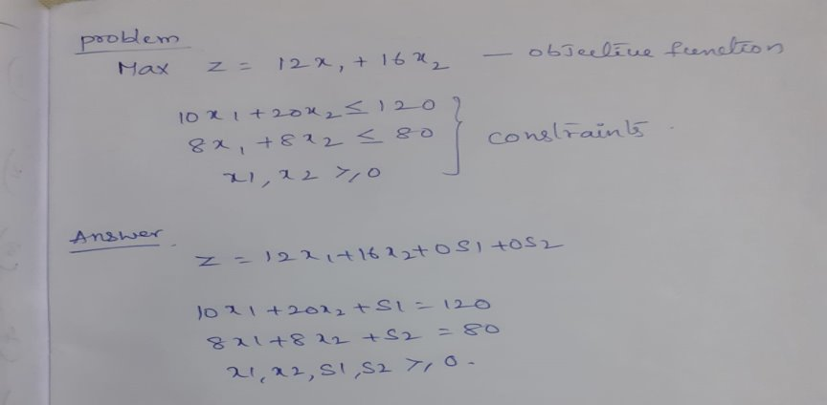
Another solved problem
Notes:
26

Slide 27
z = 12x₁ + 16x2 + 0s1 + 0s2
10x1 + 20x2 + 1s1 + 0s2 = 120
8x1 + 8x2 + 0s1 + 1s2 = 80
x1, x2, s1, s2 >= 0
 | C_{j} -> | 12 | 16 | 0 | 0
C_{Bi} | Basic variables | x1 | x2 | s1 | s2 | b | ratio
0 | s1 | 10 | 20 | 1 | 0 | 120 | 120/20
0 | s2 | 8 | 8 | 0 | 1 | 80 | 80/8
 | zj | 0 | 0 | 0 | 0 | 0
 | Cj - zj | 12 | 16 | 0 | 0
Notes:
27

Slide 28
 | C_{j} -> | 12 | 16 | 0 | 0
C_{Bi} | Basic variables | x1 | x2 | s1 | s2 | b
16 | x2 | 1/2 | 1 | 1/20 | 0 | 6
0 | s2 | 4 | 0 | -2/5 | 1 | 32
 | zj | 8 | 16 | 4/5 | 0 | 96
 | Cj - zj | 4 | 0 | -4/5 | 0
Revised tableau
Non-optimal solution
 | C_{j} -> | 12 | 16 | 0 | 0
C_{Bi} | Basic variables | x1 | x2 | s1 | s2 | b | ratio
16 | x2 | 1/2 | 1 | 1/20 | 0 | 6 | 12
0 | s2 | 4 | 0 | -2/5 | 1 | 32 | 8
 | zj | 8 | 16 | 4/5 | 0 | 96
 | Cj - zj | 4 | 0 | -4/5 | 0
Pivot element = 4
Notes:
28

Slide 29
 | C_{j} -> | 12 | 16 | 0 | 0
C_{Bi} | Basic variables | x1 | x2 | s1 | s2 | b
16 | x2 | 0 | 1 | 1/10 | -1/8 | 2
12 | x1 | 1 | 0 | -1/10 | 1/4 | 8
 | zj | 12 | 16 | 4/10 | 1 | 128
 | Cj - zj | 0 | 0 | -4/10 | -1
Revised tableau
Optimal solution
Optimal values are
z = 128
x1 = 8
x2 = 2
Notes:
29

Slide 30
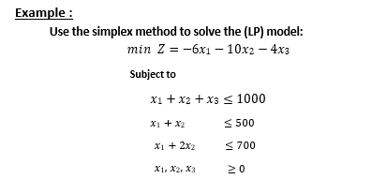
Another solved problem
≤ 500
≤ 500
Notes:
30

Slide 31
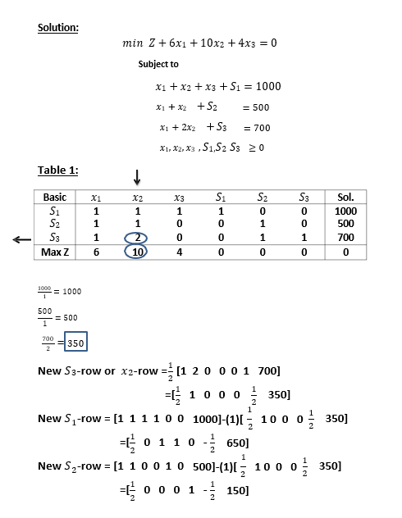
Another solved problem
≤ 500
≤ 500
Notes:
31

Slide 32
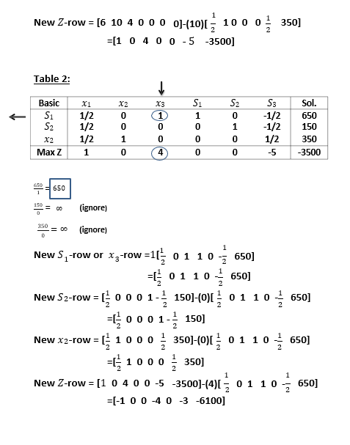
Another solved problem
≤ 500
≤ 500
Notes:
32

Slide 33
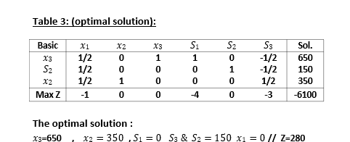
Another solved problem
≤ 500
≤ 500
Notes:
33

Slide 34
SELF-ASSESSMENT QUESTIONS
A standard form of LP problem is required to satisfy the following condition
A) The problem is a maximization problem.
B) All constraints should be of <= zero type.
C) All variables should take non-negative values.
D) All of the above
Inequalities can be converted into equality using the following type of variable
Basic
Non-basic
Slack
Any of the above
Notes:
Answer 1 b and 2 c
34

Slide 35
TERMINAL QUESTIONS
Write the steps of converting a minimization problem to a maximization problem.
List the steps of optimization following the Simplex method.
Define the following terms:
  Pivot element
  Slack variable
  Basic variable
In simplex method, what is the criterion to decide whether the optimality is reached?
Notes:
35

Slide 36
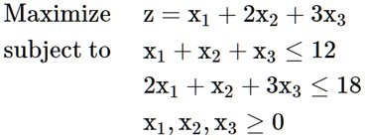
TERMINAL QUESTIONS
5) Solve the following problem using Simplex method:
6) A farmer has 100 acres of land on which she plans to grow wheat and corn. Each acre of wheat requires 4 hours of labor and $20 of capital, and each acre of corn requires 16 hours of labor and $40 of capital. The farmer has at most 800 hours of labor and $2400 of capital available. If the profit from an acre of wheat is $80 and from an acre of corn is $100, how many acres of each crop should she plant to maximize her profit? Determine using the Simplex method.
Notes:
36

Slide 37
REFERENCES FOR FURTHER LEARNING OF THE SESSION
Tutorials on Simplex method:
https://math.libretexts.org/Bookshelves/Applied_Mathematics/Applied_Finite_Mathematics_(Sekhon_and_Bloom)/04%3A_Linear_Programming_The_Simplex_Method/4.02%3A_Maximization_By_The_Simplex_Method
http://recursos.pearson.es/castroman/tutor_chaps/ct03.pdf
https://www.imse.iastate.edu/files/2015/08/Explanation-of-Simplex-Method.docx
Web links to videos:
NPTEL online course, "Linear Programming Solutions - Simplex Algorithm", Prof. G. Srinivasan, IIT Madras, https://www.youtube.com/watch?v=qxls3cYg8to

